Slide 1




New Deal

Slide 2
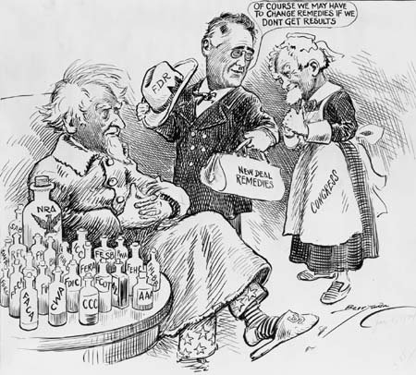
Purposes of the New Deal
Relief to provide jobs for the unemployed and to protect farmers from foreclosure
  Direct aid to people and farmers
Recovery: to get the economy back into high gear
  Back to prosperity
Reform: To regulate banks, to abolish child labor, and to conserve farm lands
  Change of laws to make sure the Great Depression doesn’t happen again

Slide 3


Bank Holiday
March 6, 1933
Closed all banks
Government investigated the banks
Only those deemed sound could re-open
Designed to improve people’s trust in banks
New Deal

Slide 4
Civilian Conservation Corps
C.C.C.
The first New Deal project introduced in March 1933
Created work for 2.5 million unemployed workers
Led to tree planting and soil conservation
Bridges, dams, nature trails and picnic areas were built
New Deal

Slide 5
Federal Emergency Relief Agency
FERA
$500 million given directly to state governments for unemployed and families
Money given directly to poor in payments
Gave $3 billion to 1/6 population
New Deal

Slide 6
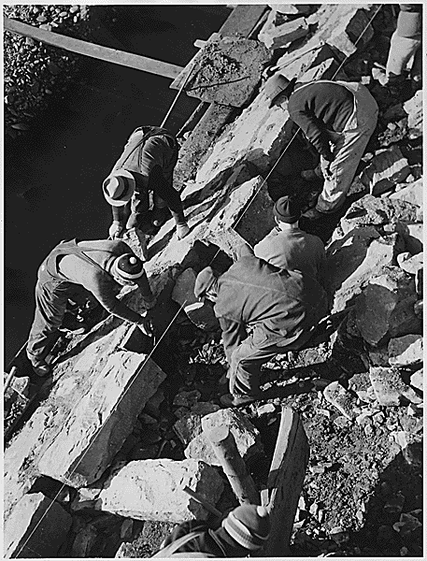
Public Works Administration
P.W.A.
Focused on unemployed skilled workers
Capital intensive rather than labor intensive – BIG projects-hired private companies to do the work
Built hospitals, roads, schools, Chicago Sewer System, Navy Destroyers
New Deal

Slide 7
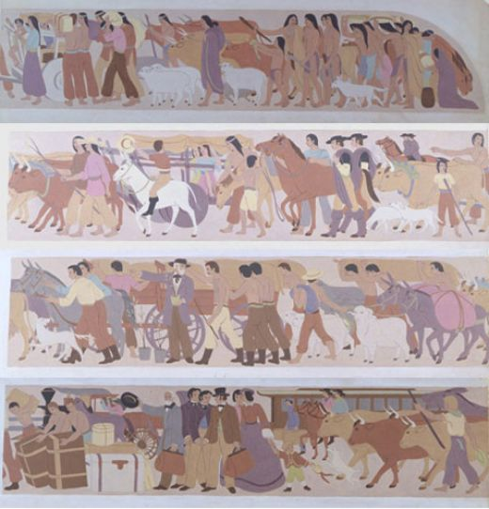

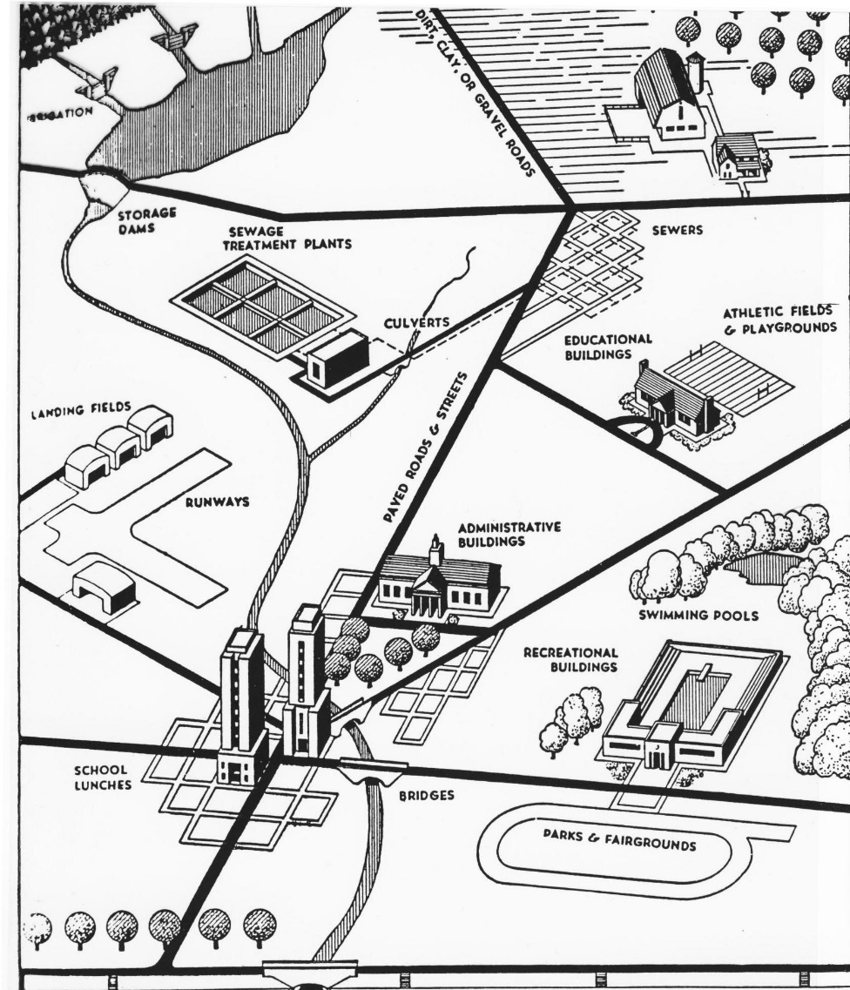
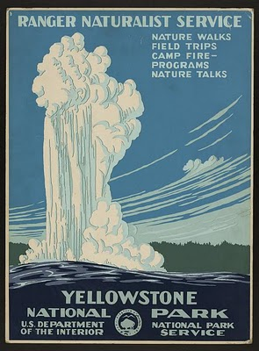
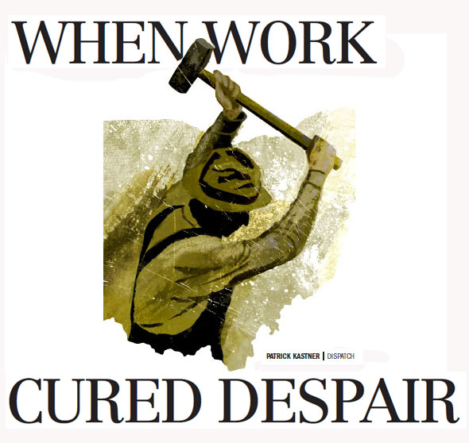
Works Progress Administration
WPA
Focused on jobs for unskilled and unemployed
From arts to roads, oral history to food distribution, parks to plays and photos
Public Projects
PJ Jacobs, Iverson Buildings

Slide 8

Social Security Act
Biggest piece of legislation ever passed! Ever! WHY?-
  Largest government program in terms
  of total $ spent
Paid for through payroll tax (FICA)
Designed to keep the elderly
out of poverty (50% in depression)

Slide 9
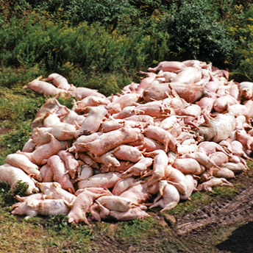

Agricultural Adjustment Act
A.A.A.
Increased prices by creating artificial scarcity, i.e. killing livestock, ploughing up crops
Parity price ( set price) established for main crops
Crop Insurance introduced
New Deal

Slide 10

Federal Housing Administration
FHA
Made affordable home loans available to a greater group of people
Kept interest rates down
Helped repair older homes

Slide 11

Tennessee Valley Authority T.V.A.
The Tennessee River was transformed:
Stopped years of deforestation and soil erosion by replanting and soil conservation.
Built a series of dams and canals for flood prevention.
Hydro-electric power for homes and business.
New Deal

Slide 12

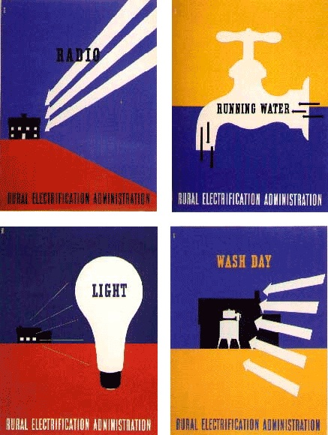
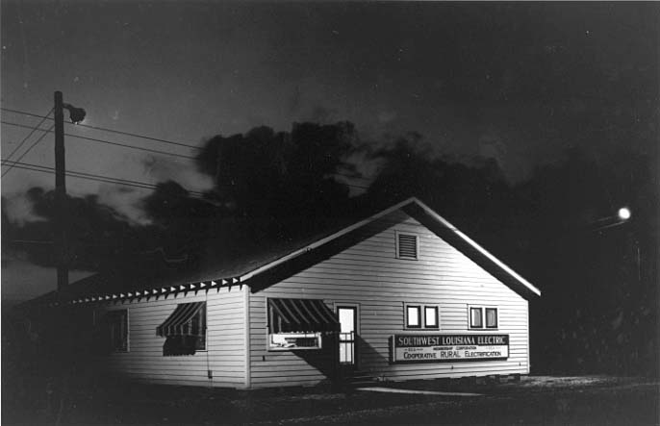
Rural Electrification Administration
R.E.A.
Brought Power to Rural areas /farms
Opened up rural areas to the world
Groups of farmers could get loans to set up electrical grid
New Deal

Slide 13
Industry – N.I.R.A. (N.R.A.)
The National Industrial Recovery Act established the National Recovery Administration:
Industry could establish codes of behavior for themselves
Industries could not encourage monopolies
Encouraged labor unions and collective bargaining
Banned yellow-dog contracts
Eventually declared unconstitutional and was replaced by the NLRB and the NLR Act-2nd New Deal
New Deal

Slide 14

Securities and Exchange Commission
SEC
Securities Act - 1934
Stricter federal rules for companies and stock exchanges
Companies had to be honest when providing information to investors
New Deal

Slide 15
National Labor Relations Board
NLRB
Workers could start a union- had right to bargain collectively and strike
Gov’t would regulate management & unions to prevent abuses
  Took place of NIRA rules after being ruled unconstitutional
New Deal

Slide 16

Industry – Fair Labor
Standards Act
Standards for workers:
Set a minimum wage of 40 cents an hour
Set a maximum working week of 40 hours
Banned child labor
New Deal

Slide 17
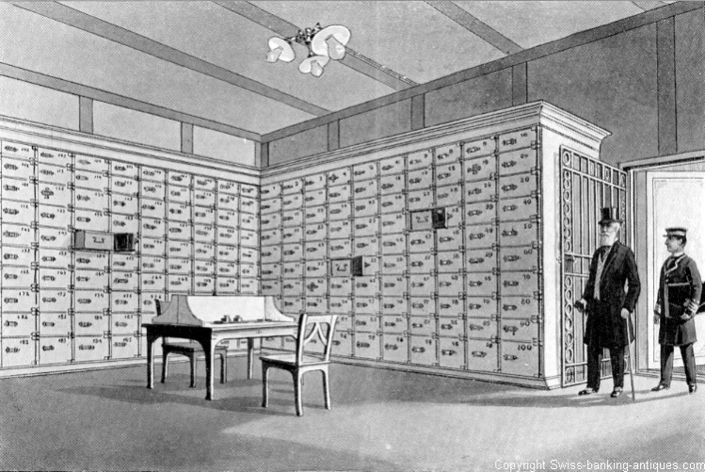

Federal Deposit Insurance Corporation
Banking Acts 1933 and 1935
Investors’ deposits insured
Monitored soundness of banks
People trusted banks – put money back.
Also for Credit Unions and Savings and Loans
New Deal

Slide 18

Impact of the New Deal
Social Security – allows people to retire
SEC – Polices stocks & securities
AAA- Still have farm subsidies
FDIC – faith in banks
NLRB & 40 hour week – workers still have rights to unionize/ get paid for over 40 hours of work
FHA- Help w/ poor getting housing

Slide 19
Success or Failure?
Still 6 million out of work in 1941.
African Americans & women gained little
Some programs declared unconstitutional by courts
Roosevelt tried to cheat system by “packing Supreme Court”
Didn’t get us out of Depression
Reduced unemployment by 7 million
Made workers feel better
The Stock Market and banks recovered
Built Infrastructure
Many programs/ products of programs - still exist today

Slide 20

Criticisms
Conservative opponents said the New Deal went too far:
  It was socialism (killed individualism)
  It added to the national debt ($35 billion)
  It wasted money on relief and encouraged idleness
  It violated the constitution & states rights
  It increased the power of the
  Presidency (FDR was reaching
  toward dictatorship, Congress a
  rubber stamp, independence
  of judiciary threatened,
  separation of powers shattered)

Slide 21
