Slide 1
Understanding India and Gandhi

Slide 2
India Basics
http://www.bbc.com/news/world-south-asia-12557384
http://www.bbc.com/news/world-south-asia-12557386

Slide 3
Understanding India
Because of the Silk Road in trading goods to and from India a company becomes into power
East India trading Company
Accounted for half the worlds trade of items like cotton, silk, salt, and tea
Over time this company gains more and more influence and control
This company is full of British aristocrats and merchants
Britain has imperial rule over India for centuries through indirect rule
British Raj- Indian leadership, but works for British

Slide 4
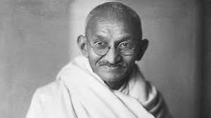
India 20th Century
Over time Indians continue to gain small victories in gaining their own independence, but still being ruled by British
Now these movements begin to change with mass movements against British Raj and British Rule/
One of these key leaders is Mahatma Gandhi

Slide 5
New Independence
Gandhi continues to lead marches and peaceful protest against British Rule
After WWII- British are near bankrupt and decide they cannot be in charge of India anymore
Problem- Unite or Divide India
1947 India has Hindu majority, but also millions of Muslims
You cant rule democratically with religious majority

Slide 6
Result
A bloody battle ensues separating India into-
West Pakistan-
East Pakistan-now Bangladesh
India

Slide 9
Dev Bhoomi-Land of Gods

