Slide 1
United Nations Structure

Slide 2
United Nations
Think about?
Not all of these problems exist in the U.S.
Connection to Basic, Secondary, Tertiary needs
Which of the three do you think the United Nations help with the most? Why?

Slide 3
United Nations
United Nations has 6 main organs
General Assembly
Security Council
Economic and Social Council
International Court of Justice
Secretatriat
The Trusteeship Council

Slide 4
Structure of United Nations
General Assembly- All countries are represented-193 countries
Can discuss anything that is in the U.N. Charter
All country discussions
Main forum for any issues
What is in the U.N. Charter? main points
Maintain international Peace and Security
Respect all Human Rights
Create universal international laws
Create military, economic, or diplomatic sanctions to solve disputes

Slide 5
Committees of General Assembly
First Committee (Disarmament & International Security)
Second Committee (Economic & Financial)
Third Committee (Social, Humanitarian & Cultural)
Fourth Committee (Special Political & Decolonization)
Fifth Committee (Administrative & Budgetary)
Sixth Committee (Legal)

Slide 6
Structure of United Nations
Security Council- 5 Permanent Members
U.S., U.K., Russia, France, China
Why those 5?
Countries have veto power
Also 10 others are involved but on rotating basis
Can use Power to impose economic sanctions, withdraw aid, and/or can use force in conflicts and peace-keeping operations

Slide 7
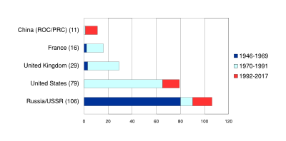
Using Veto Power

Slide 8
Structure of United Nations
Economic and Social Council- 54 members
Leaders in UN’s economic, social, humanitarian, and cultural interests
Deals with human rights, population, technology and drugs

Slide 9
Structure of United Nations
International Court of Justice (World Court)-
Settles legal disputes by states
Supreme court of the World!!

